Slide 1

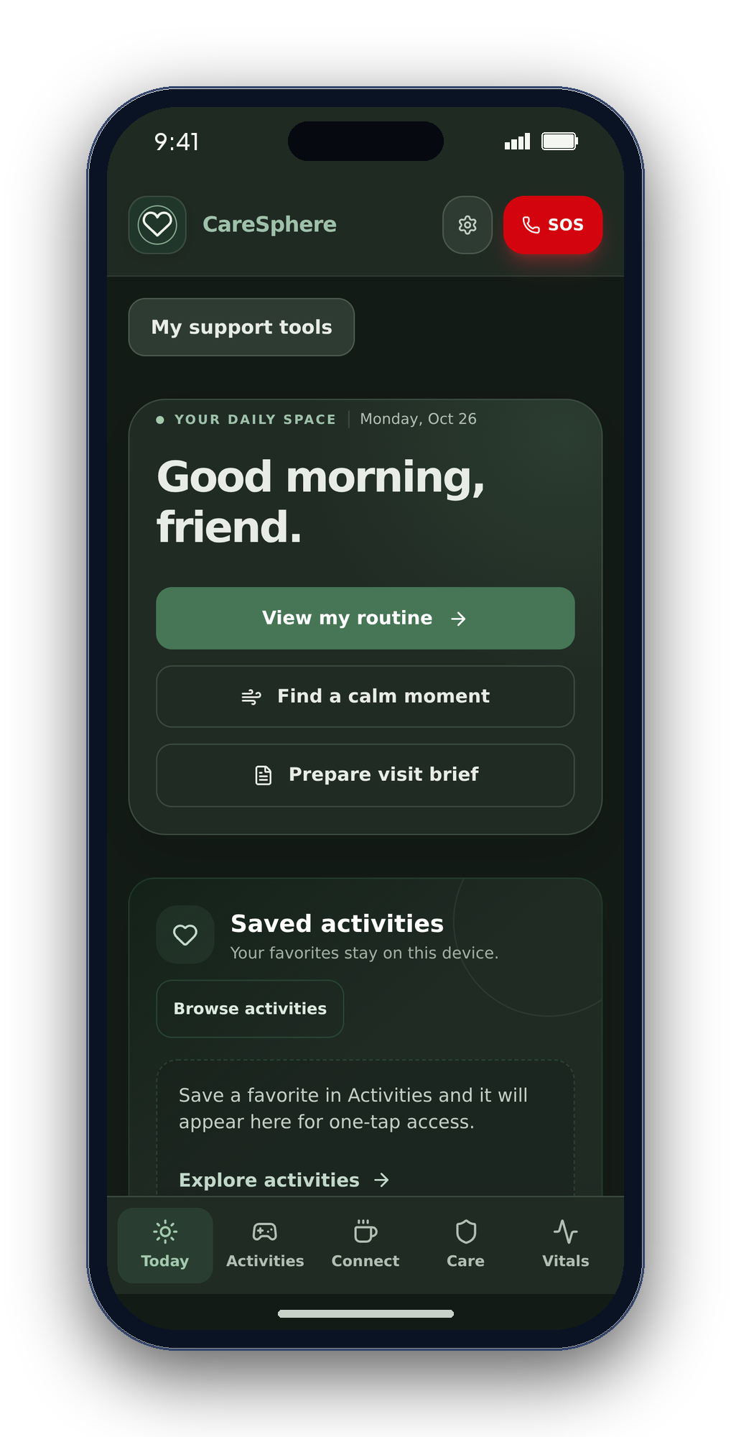
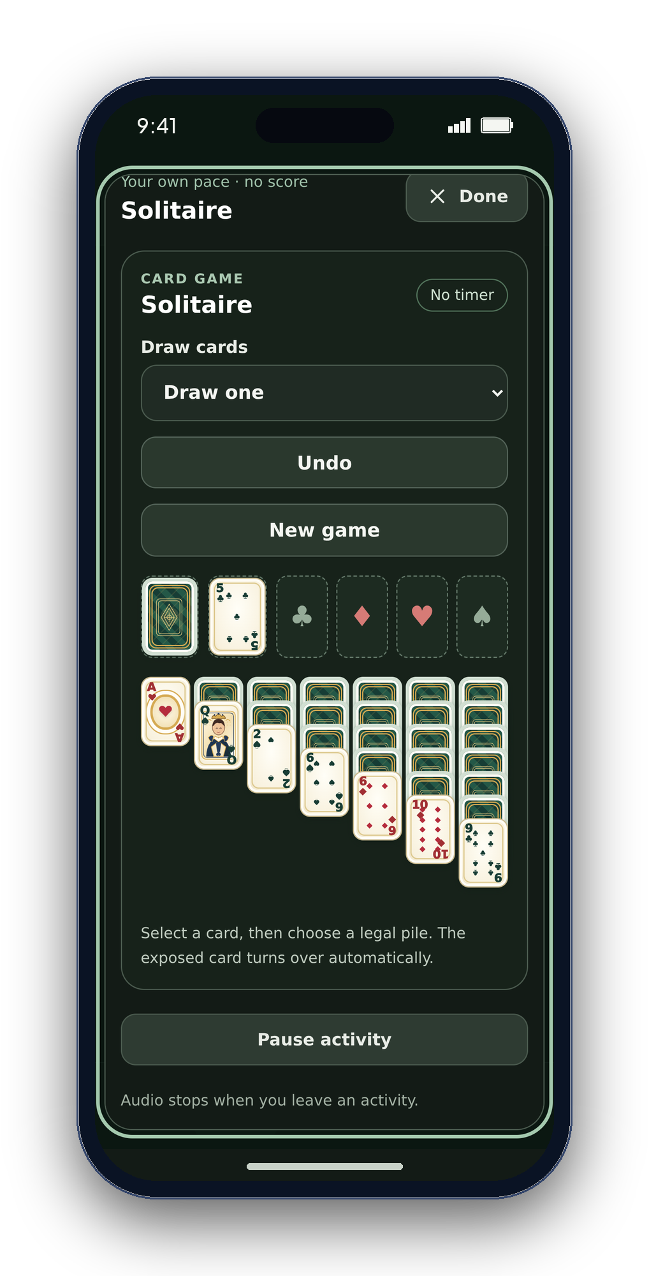
CONGRESSIONAL APP CHALLENGE · APP DEMONSTRATION
CareSphere
Your wellness, your way.
Activities, daily routines, connection and help preparing for care visits.
DESIGNED FOR
Older adults, people living with dementia, autistic people, and the families and caregivers who support them.
Arnav Kochar · 9th grade · Congressional District 10
Notes:
SLIDE 1 · 0:00–0:12 · Introduction
SAY: Hi, I’m Arnav Kochar, a freshman in District 10. CareSphere brings daily support together for older adults, people living with dementia, autistic people, and caregivers.
Actual mobile web screenshots from source a3d9e4489c935b67e4a6c55c133b02a2e639d6df inside script-drawn iPhone-style frames. Device status area and frame are outside the captured UI. Not native screenshots or clinical validation. No AI-generated imagery.
EXPANDED SCRIPT (longer than the 3-minute recording cut):
Hi, I’m Arnav Kochar, a freshman in Congressional District 10, and this is CareSphere: Your wellness, your way. CareSphere is a human-centered, privacy-first care assistant that helps older adults, people living with dementia, autistic people, and caregivers manage daily routines, well-being, connection, and care visits in one place.
The title identifies Arnav Kochar, 9th grade, and Congressional District 10 as requested. Introduce yourself aloud in the actual recording. No email, school or direct contact information is printed.

Slide 2

02
USER-FRIENDLY DESIGN
Simple to use. Built around people.
Clear choices. A comfortable pace.
A predictable day
Mood check-ins, daily routines and medication reminders.
A low-pressure activity
Familiar activities, optional sound and clear stop controls.
A way to connect
Video rooms and a brief you prepare before a visit.
CareSphere AI
Notes:
SLIDE 2 · 0:12–0:24 · Why I built it
SAY: Watching my grandparents in India manage independently, and talking with an autistic friend, showed me how often apps overlook different needs. I wanted to build something more accessible.
Actual mobile web screenshots from source a3d9e4489c935b67e4a6c55c133b02a2e639d6df inside script-drawn iPhone-style frames. Device status area and frame are outside the captured UI. Not native screenshots or clinical validation. No AI-generated imagery.
EXPANDED SCRIPT (longer than the 3-minute recording cut):
Seeing my grandparents in India manage daily life independently, and talking with an autistic friend, helped me notice how often apps overlook different needs. I wanted to build an app that could support older adults, people living with dementia, and autistic people without making everyday technology feel more complicated.

Slide 3
03
WHAT THE APP DOES
Everyday support. Six connected areas.
Sensory & interactive activities
Daily support
16 activities with search, favorites and pace choices.
Mood check-ins, reminders and a moment to pause.
Human connection
Notes & care visits
Coffee Circles and video calls you choose to join.
Choose notes to share and prepare a visit summary.
Health readings
Make it your own
Readings from a monitor or records you enter yourself.
Simpler screens, language choices and comfort settings.
Also: emergency options · save a backup · decide what to share
CareSphere AI
Notes:
SLIDE 3 · 0:24–0:35 · One place for daily support
SAY: CareSphere combines routines, reminders, mood check-ins, calming tools, activities, calls, notes, visit preparation, health readings, and emergency options. People choose their language and comfort settings.
Actual mobile web screenshots from source a3d9e4489c935b67e4a6c55c133b02a2e639d6df inside script-drawn iPhone-style frames. Device status area and frame are outside the captured UI. Not native screenshots or clinical validation. No AI-generated imagery.
EXPANDED SCRIPT (longer than the 3-minute recording cut):
CareSphere combines routines, medication reminders, mood check-ins, calming tools, activities, video calls, care notes, visit preparation, health readings, and emergency options in one app. People can adjust the screens, language, and comfort settings to suit their preferences.

Slide 4
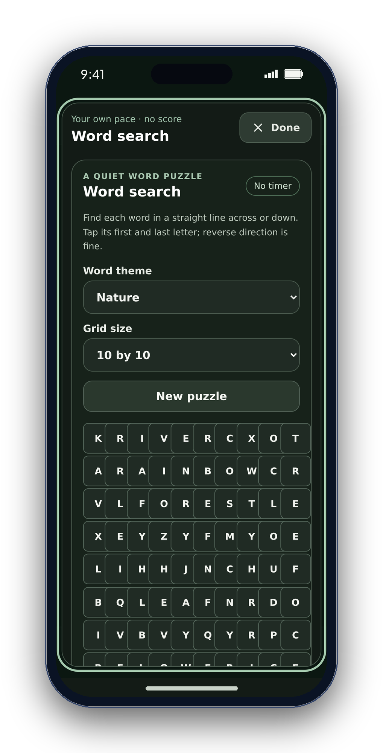
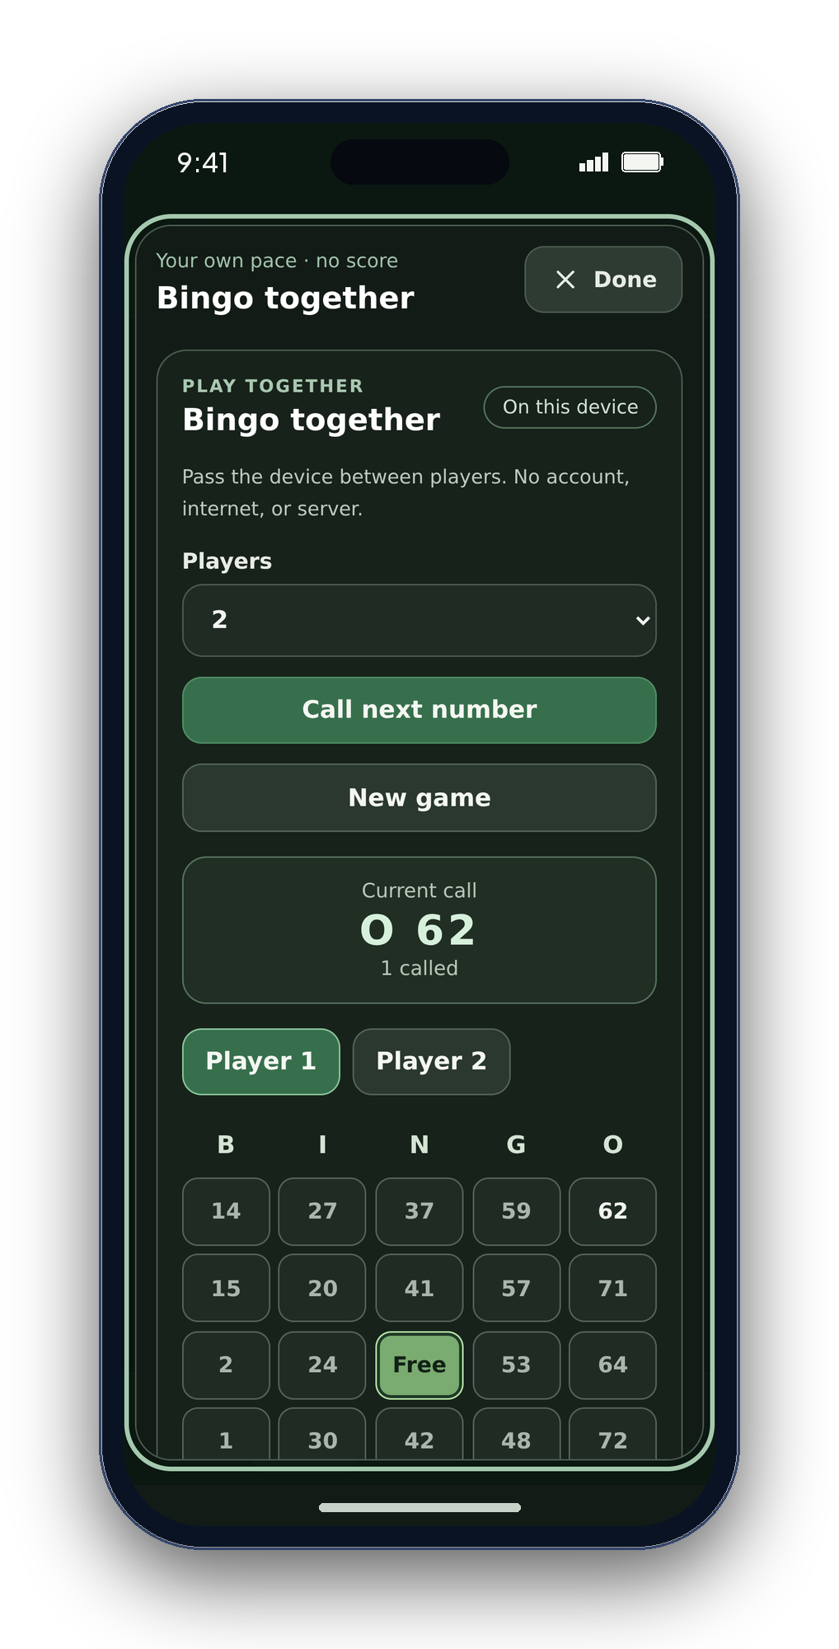
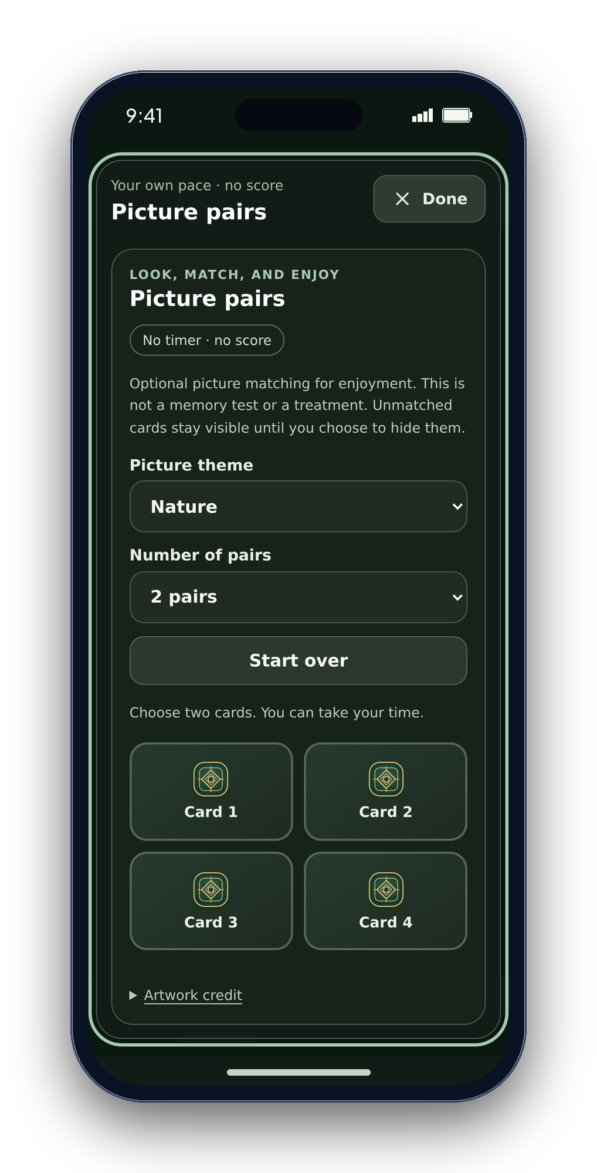
04
CORE FEATURE · ACTIVITIES
Activities. At your own pace.
Solitaire
Word Search
Bingo
Picture Pairs
Draw · undo · no timer
Themes · word selection
Together on one device
Reveal matching cards
Also: remembering patterns · picture stories · feelings · sorting · conversations · and more
CareSphere AI
Notes:
SLIDE 4 · 0:35–0:45 · Activities at your own pace
SAY: Sixteen activities include Solitaire, Word Search, Bingo, picture matching, stories, sorting, and conversation. There is no timer or score.
Actual mobile web screenshots from source a3d9e4489c935b67e4a6c55c133b02a2e639d6df inside script-drawn iPhone-style frames. Device status area and frame are outside the captured UI. Not native screenshots or clinical validation. No AI-generated imagery.
EXPANDED SCRIPT (longer than the 3-minute recording cut):
The library has sixteen activities, including Solitaire, Word Search, Bingo, Picture Pairs, memory activities, stories, sorting, and conversation. They are designed to be simple and easy to enjoy, with no timer or score.

Slide 5
05
RESEARCH AND DESIGN
Research behind CareSphere.
Research informs the design; CareSphere itself has not been clinically evaluated.
Population
Research findings
How CareSphere responds
Dementia
Digital interventions may support cognition and well-being (Ditton et al., 2025).
Memory games, stories, routines and calming tools.
Autism
Predictable structure and individual needs matter in technology design (Maun et al., 2024).
Consistent navigation, customizable settings and sensory tools.
Older adults
Video calls may improve social support and reduce loneliness (Noh et al., 2025).
Opt-in Coffee Circles, video calls and daily reminders.
Personalized support · Accessible experiences · Meaningful connection
Sources: Ditton et al. (2025), Dementia; Maun et al. (2024), Journal of Autism and Developmental Disorders; Noh et al. (2025), Geriatric Nursing.
CareSphere AI
Notes:
SLIDE 5 · 0:45–0:58 · Research behind CareSphere
SAY: Research guided the design: tailored support, predictable choices, and social connection. CareSphere responds with activities, customizable settings, and optional video rooms. The studies do not establish CareSphere’s clinical effectiveness.
Actual mobile web screenshots from source a3d9e4489c935b67e4a6c55c133b02a2e639d6df inside script-drawn iPhone-style frames. Device status area and frame are outside the captured UI. Not native screenshots or clinical validation. No AI-generated imagery.
EXPANDED SCRIPT (longer than the 3-minute recording cut):
Research helped shape the design. Ditton and colleagues describe potential benefits of digital support for cognition and well-being. Maun and colleagues emphasize predictable structure and individual needs. Noh and colleagues report benefits from video-call interventions. These findings inform CareSphere’s activities, settings, calming tools, and social features; they do not establish that CareSphere itself is clinically effective.
R1: Exploring the effectiveness and experiences of people living with dementia interacting with digital interventions: A mixed methods systematic review
https://doi.org/10.1177/14713012241302371
https://pubmed.ncbi.nlm.nih.gov/39604136/
Limit: Included dementia or mild cognitive impairment. Benefits depended on motivation, tailored training, support, suitable devices and content. Findings about studied programs do not establish CareSphere outcomes. The abstract was checked, not every included trial.
R2: Participatory Methods to Engage Autistic People in the Design of Digital Technology: A Systematic Literature Review
https://doi.org/10.1007/s10803-023-06015-5
https://pmc.ncbi.nlm.nih.gov/articles/PMC11300472/
Limit: 2024 journal issue; first published online in May 2023. Review of 18 articles on design participation, not an efficacy trial. Supports involving autistic people as equal design partners; CareSphere does not claim such involvement has already occurred.
R3: Effectiveness and recommendation strategies for videoconference-based interventions to alleviate social isolation and loneliness in older adults: A systematic review and meta-analysis
https://doi.org/10.1016/j.gerinurse.2025.03.042
https://pubmed.ncbi.nlm.nih.gov/40239396/
Limit: Geriatric Nursing 63 (2025), 353–361. Review of ten videoconference-based intervention studies: small-to-medium effect on social support and small effects on loneliness and depressive symptoms. This does not test CareSphere, prove that simply providing a room link reduces loneliness, or support a benefit claim for daily reminders. Responses in the table are design choices, not individually validated interventions.

Slide 6
06
LIVE APP DEMONSTRATION
Let me show you
CareSphere in action.
Choose what you need, in any order.
REAL APP · NO PRIVATE DATA
CareSphere AI
Notes:
SLIDE 6 · 0:58–1:01 · Demonstration handoff
SAY: Now, let me show you CareSphere in action.
Actual mobile web screenshots from source a3d9e4489c935b67e4a6c55c133b02a2e639d6df inside script-drawn iPhone-style frames. Device status area and frame are outside the captured UI. Not native screenshots or clinical validation. No AI-generated imagery.
EXPANDED SCRIPT (longer than the 3-minute recording cut):
Now, let me show you CareSphere in action. Choose what you need, in any order.
Switch immediately to real app footage for 70 seconds; resume at slide 7.

Slide 7
07
TOOLS, LANGUAGES AND PRIVACY
Three platforms. Local-first care.
Web
iPhone source
Android source
JavaScript
Swift
Kotlin
React · Vite · Web Audio
Web Bluetooth · Web Crypto
SwiftUI · HealthKit
Optional Apple Foundation Models
Android UI · BLE
Read-only Health Connect
Encrypted local care data. Reviewed, selected sharing.
Jitsi uses external services. New native activity builds and physical-device validation remain pending.
CareSphere AI
Notes:
SLIDE 7 · 2:11–2:21 · Tools, languages and privacy
SAY: Web uses React and JavaScript; iPhone, SwiftUI; Android, Kotlin. Data is encrypted locally. Eligible iPhones offer Apple’s on-device AI.
Actual mobile web screenshots from source a3d9e4489c935b67e4a6c55c133b02a2e639d6df inside script-drawn iPhone-style frames. Device status area and frame are outside the captured UI. Not native screenshots or clinical validation. No AI-generated imagery.
EXPANDED SCRIPT (longer than the 3-minute recording cut):
The web app uses React and JavaScript; iPhone uses Swift and SwiftUI; and Android uses Kotlin. Core features are account-free, with care data encrypted locally. A generation check rejects stale Bluetooth readings. Eligible iPhones can use Apple Foundation Models on-device. MedlinePlus links provide general health information—not diagnosis or treatment advice.

Slide 8
08
WHO THIS COULD SUPPORT
Different needs. Shared daily support.
61.2 million
7.4 million
Older adults
Alzheimer’s dementia
Americans age 65+ · 2024
Americans age 65+ · 2026 estimate
[S1] U.S. Census Bureau · 2024 data
[S2] Alzheimer’s Association · 2026
63 million
1 in 31
Family caregivers
Autism identification
U.S. family caregivers · 2025
8-year-olds in CDC monitoring communities · 2022
[S3] AARP / National Alliance for Caregiving · 2025
[S4] Centers for Disease Control and Prevention · 2022 data
Different years and populations. These figures overlap; they are not app-user counts.
CareSphere AI
Notes:
SLIDE 8 · 2:21–2:34 · Who this could support
SAY: These figures show why accessible daily support matters. They describe different U.S. populations and years—not CareSphere users or new diagnoses.
Actual mobile web screenshots from source a3d9e4489c935b67e4a6c55c133b02a2e639d6df inside script-drawn iPhone-style frames. Device status area and frame are outside the captured UI. Not native screenshots or clinical validation. No AI-generated imagery.
EXPANDED SCRIPT (longer than the 3-minute recording cut):
These figures show the scale of different needs: older adults, people living with Alzheimer’s dementia, family caregivers, and autistic children identified in CDC monitoring communities. Each figure has its own year and population. They overlap and are not counts of CareSphere users.
[S1] U.S. Census Bureau · 2024 data: 61.2 million — Older adults; Americans age 65+ · 2024
https://www.census.gov/newsroom/press-releases/2025/older-adults-outnumber-children.html
Scope: Vintage 2024 population estimate, published June 26, 2025. Ages 65 and older; not a count of app users.
[S2] Alzheimer’s Association · 2026: 7.4 million — Alzheimer’s dementia; Americans age 65+ · 2026 estimate
https://www.alz.org/alzheimers-dementia/facts-figures
Scope: Estimated people living with Alzheimer’s dementia, not all dementia types and not new cases per year.
[S3] AARP / National Alliance for Caregiving · 2025: 63 million — Family caregivers; U.S. family caregivers · 2025
https://www.aarp.org/pri/topics/ltss/family-caregiving/caregiving-in-the-us-2025/
Scope: Family caregivers of adults or children with chronic, disabling or serious health conditions. The report includes some compensated caregivers; this is not an unpaid-only count.
[S4] Centers for Disease Control and Prevention · 2022 data: 1 in 31 — Autism identification; 8-year-olds in CDC monitoring communities · 2022
https://www.cdc.gov/autism/data-research/index.html
Scope: Combined monitoring-site estimate for identified autism among children aged eight in 2022. Not a count of autistic people of every age or annual new diagnoses.
These populations overlap and must not be added together. Do not interpret prevalence as annual new diagnoses, market size or actual CareSphere users.

Slide 9
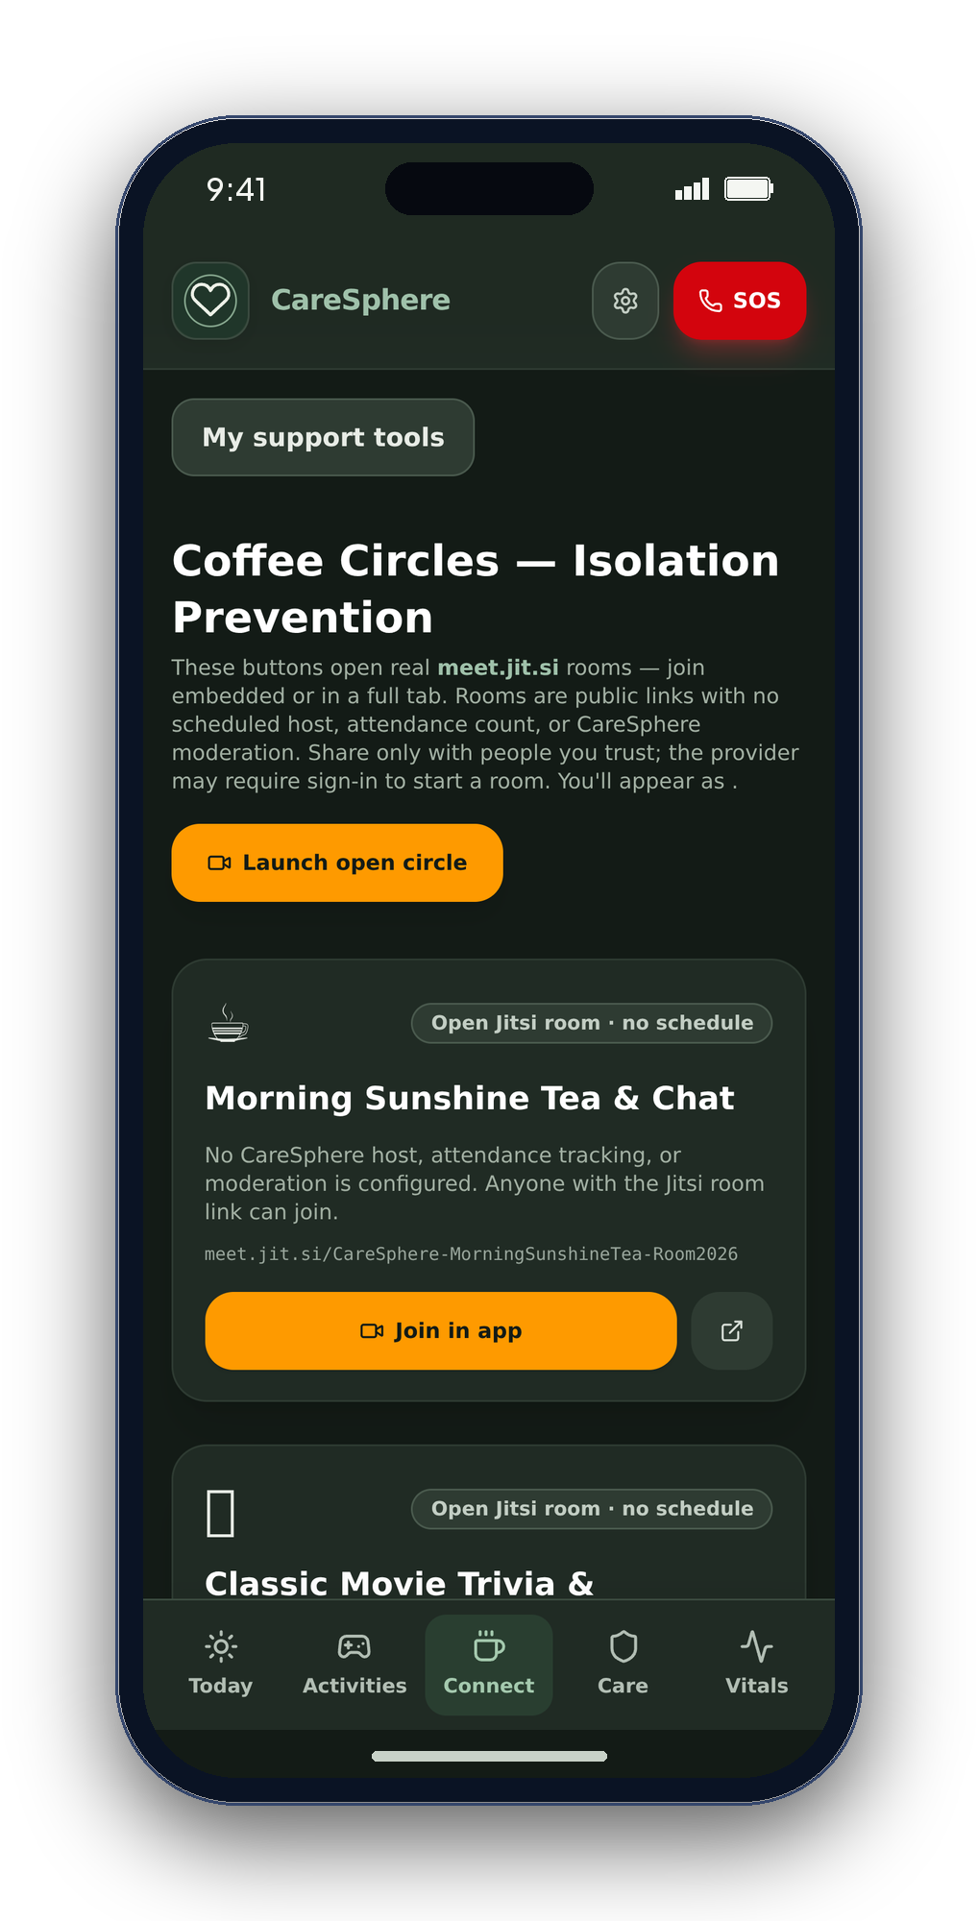
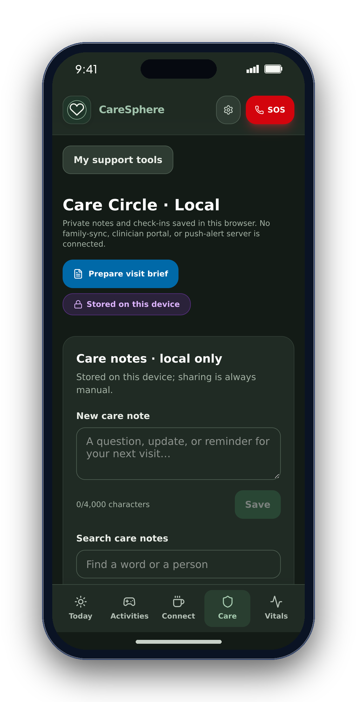
09
HUMAN CONNECTION
Reach someone. Keep control.
Coffee Circles
Choose a video room and join when you are ready.
Care Circle
Keep notes on your device and prepare for conversations.
No invisible sharing
Nothing is sent to family or a clinician on its own.
CareSphere AI
Notes:
SLIDE 9 · 2:34–2:39 · Connection is your choice
SAY: Join Coffee Circles when you choose. Notes stay on-device; calls use Jitsi.
Actual mobile web screenshots from source a3d9e4489c935b67e4a6c55c133b02a2e639d6df inside script-drawn iPhone-style frames. Device status area and frame are outside the captured UI. Not native screenshots or clinical validation. No AI-generated imagery.
EXPANDED SCRIPT (longer than the 3-minute recording cut):
Coffee Circles are video rooms you choose to join. Care Circle notes stay on your device; nothing is automatically sent to family or clinicians. Calls use the external Jitsi service.

Slide 10
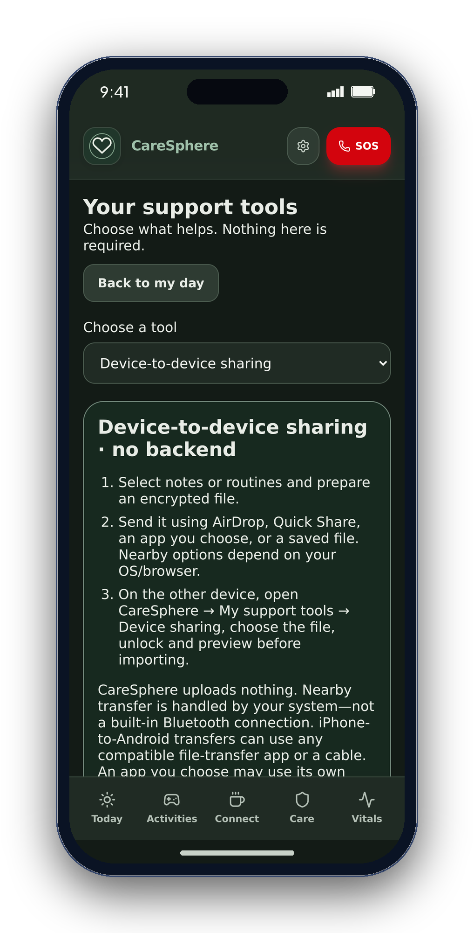
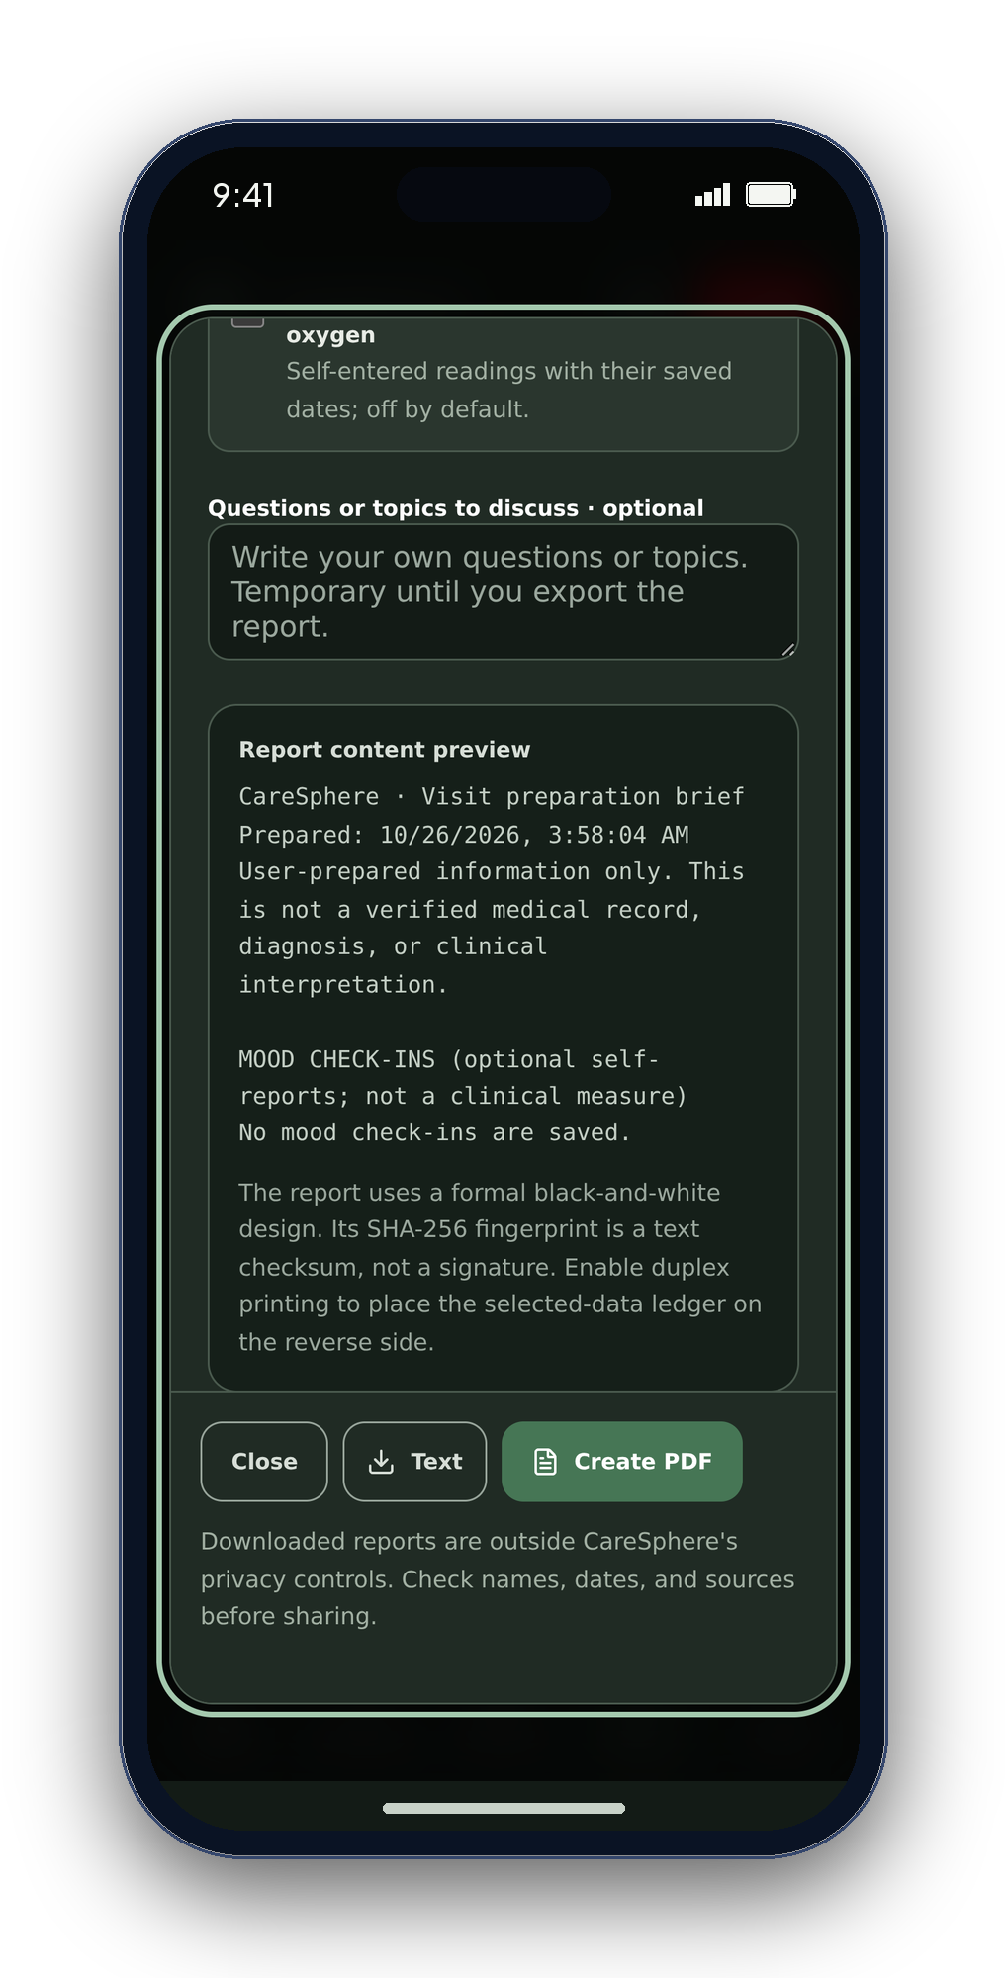
10
YOU DECIDE WHAT TO SHARE
Choose. Review. Then share.
01 · Select
Include only the records you choose.
02 · Review
Read your visit summary before saving it.
03 · Share intentionally
Review what you send. Nothing is shared on its own.
Keep saved reports safe. A visit summary is not a medical record.
CareSphere AI
Notes:
SLIDE 10 · 2:39–2:44 · Preparing for a care visit
SAY: Choose records, review your summary, then decide whether to share it with your provider.
Actual mobile web screenshots from source a3d9e4489c935b67e4a6c55c133b02a2e639d6df inside script-drawn iPhone-style frames. Device status area and frame are outside the captured UI. Not native screenshots or clinical validation. No AI-generated imagery.
EXPANDED SCRIPT (longer than the 3-minute recording cut):
Before a visit, choose the records you want to include, review the summary, and decide whether to share it with a care provider. It can help organize your questions and self-entered information for that conversation. The provider makes clinical decisions; the summary is not a diagnosis or verified medical record.

Slide 11
11
WHAT COMES NEXT
Build with people. Keep improving.
Listen to people
Ask people who may use the app what works for them.
Check ease of use
Find out which tasks feel clear and comfortable.
Check on devices
Test the latest activities on phones before release.
Next: listen, test and improve with the people who use it.
CareSphere AI
Notes:
SLIDE 11 · 2:44–2:47 · What comes next
SAY: Next: user feedback, accessibility improvements, and device testing.
Actual mobile web screenshots from source a3d9e4489c935b67e4a6c55c133b02a2e639d6df inside script-drawn iPhone-style frames. Device status area and frame are outside the captured UI. Not native screenshots or clinical validation. No AI-generated imagery.
EXPANDED SCRIPT (longer than the 3-minute recording cut):
The next major update will be guided by feedback, needs, and experience. I plan to improve VoiceOver and Dynamic Type support and test Bluetooth, time zones, reminders, and encryption on real devices. Trust means reliability.

Slide 12
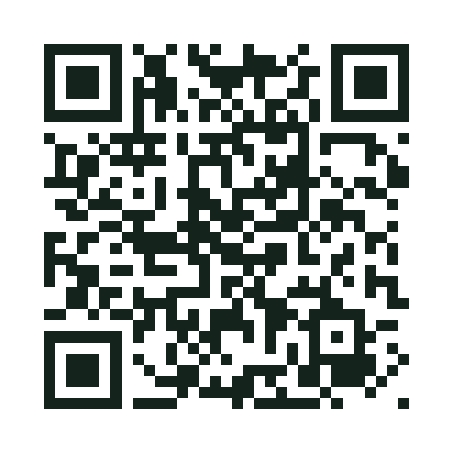
Explore the project
Care that stays yours.
Everyday support, on your terms.
EXPLORE THE PROJECT
READ THE CODE
EXPLORE THE APP
github.com/engineer2025-sudo/CareSphere
Notes:
SLIDE 12 · 2:47–2:56 · Contribution and closing
SAY: I used Claude Code and Arena.ai for debugging, reviewing changes myself. Thank you—technology should adapt to people.
Actual mobile web screenshots from source a3d9e4489c935b67e4a6c55c133b02a2e639d6df inside script-drawn iPhone-style frames. Device status area and frame are outside the captured UI. Not native screenshots or clinical validation. No AI-generated imagery.
EXPANDED SCRIPT (longer than the 3-minute recording cut):
CareSphere is my first iOS app, built with purpose and shared with pride. I used Claude Code and Arena.ai for debugging and test ideas while reviewing and checking changes myself. Thank you for watching! Explore CareSphere through the project link on screen—and remember, technology should adapt to people, not the other way around.
QR destination (presenter-selected GitHub project, not a live deployment): https://github.com/engineer2025-sudo/CareSphere

